Slide 1
Tableau Dashboard
- Harshil Gandhi

Slide 2
Tableau Dashboard
A dashboard is a consolidated display of many worksheets and related information in a single place.
It is used to compare and monitor a variety of data simultaneously.
The different data views are displayed all at once.

Slide 3
Dashboards are shown as tabs at the bottom of the workbook and they usually get updated with the most recent data from the data source.
While creating a dashboard, you can add views from any worksheet in the workbook along with many supporting objects such as
Text areas
Web pages
Images.

Slide 4
Make sure, You are Ready with your Homework(With all the charts with proper Naming Convention).
It’s ShowTime.. !

Slide 5
Objective ??
Using the Sample-superstore, Plan to create a dashboard…!
showing the sales and profits for different segments and Sub-Category of products across all the states.

Slide 6
Step 1
Create a blank worksheet by using the add worksheet icon located at the bottom of the workbook.
Drag the dimension Segment to the columns shelf and the dimension Sub-Category to the Rows Shelf.
Drag and drop the measure Sales to the Color shelf and the measure Profit to the Size shelf.
This worksheet is referred as the Master worksheet.
Right-click and rename this worksheet as Sales_Profits.

Slide 7
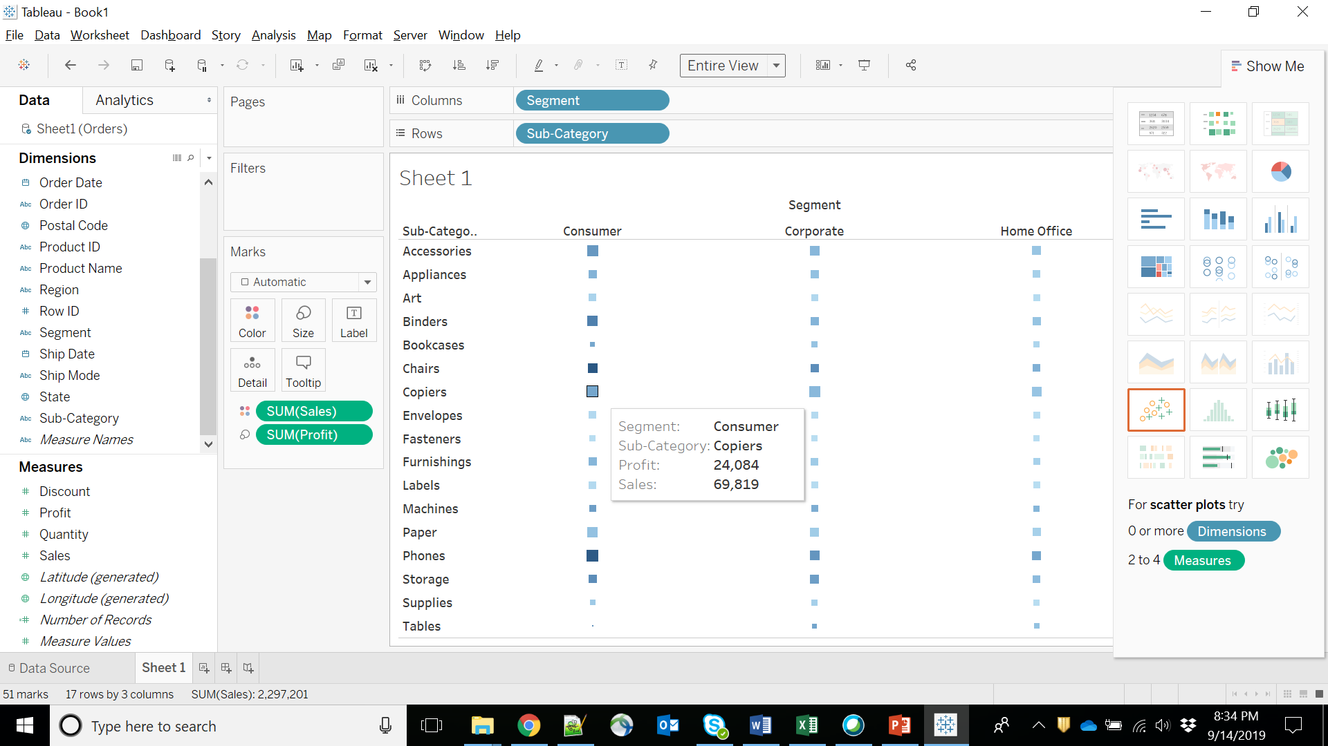

Slide 8
Step 2
Create another sheet to hold the details of the Sales across the States.
For this, drag the dimension State to the Rows shelf and the measure Sales to the Columns shelf as shown in the following screenshot.
Next, apply a filter to the State field to arrange the Sales in a descending order.
Right-click and rename this worksheet as Sales_state.

Slide 9
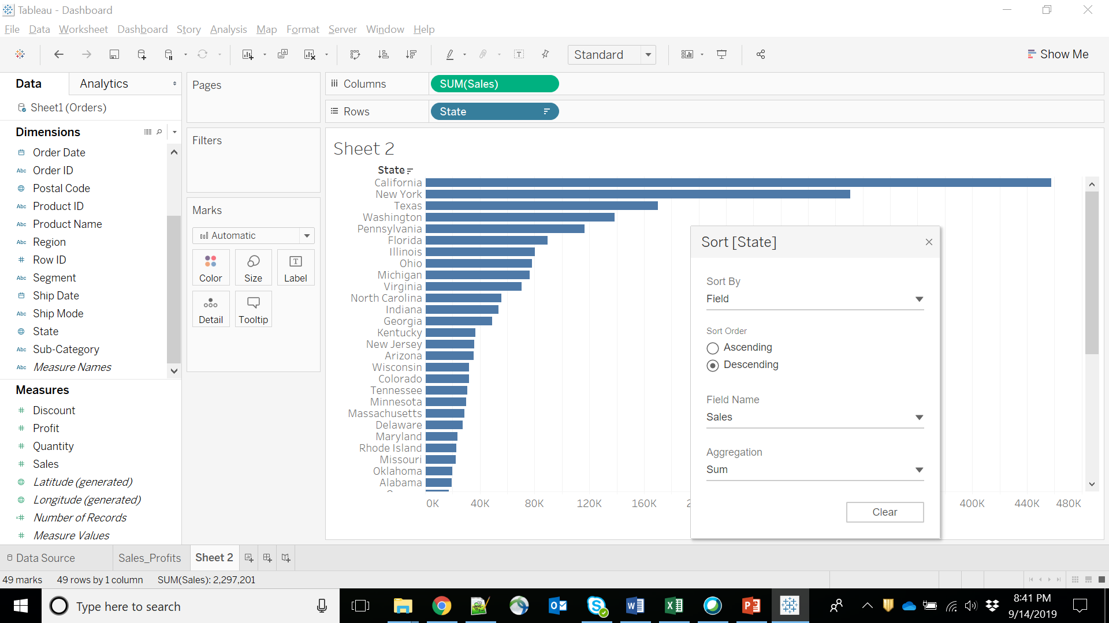

Slide 10
Step 3:
create a blank dashboard by clicking the Create New Dashboard link at the bottom of the workbook.
Right-click and rename the dashboard as Profit_Dashboard.

Slide 11
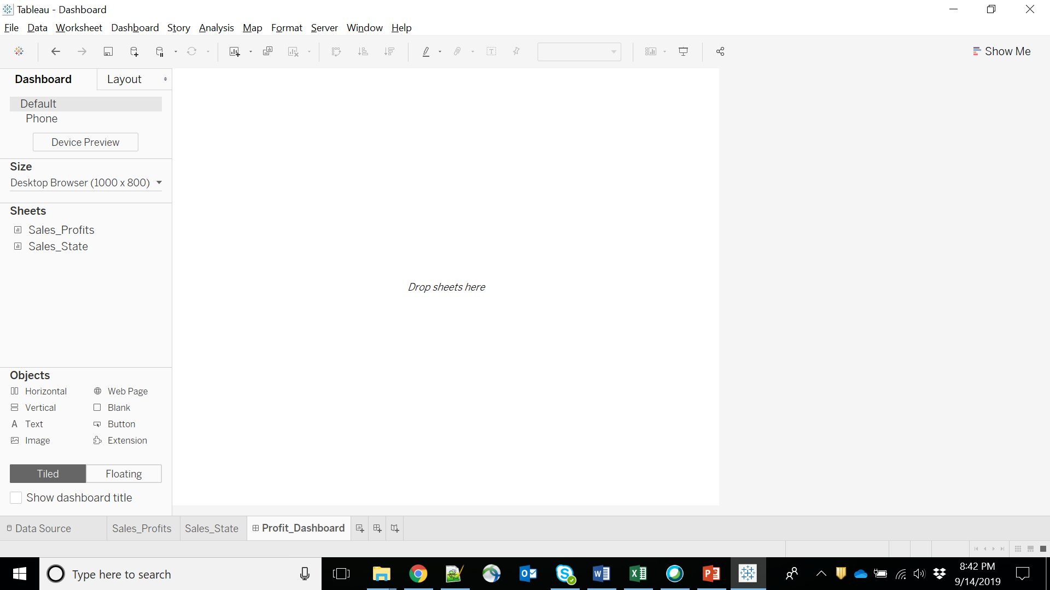

Slide 12
Step 4:
Drag the two worksheets to the dashboard.
Near the top border line of Sales Profit worksheet, you can see three small icons.
Click the middle one, which shows the prompt Use as Filter on hovering the mouse over it.

Slide 13
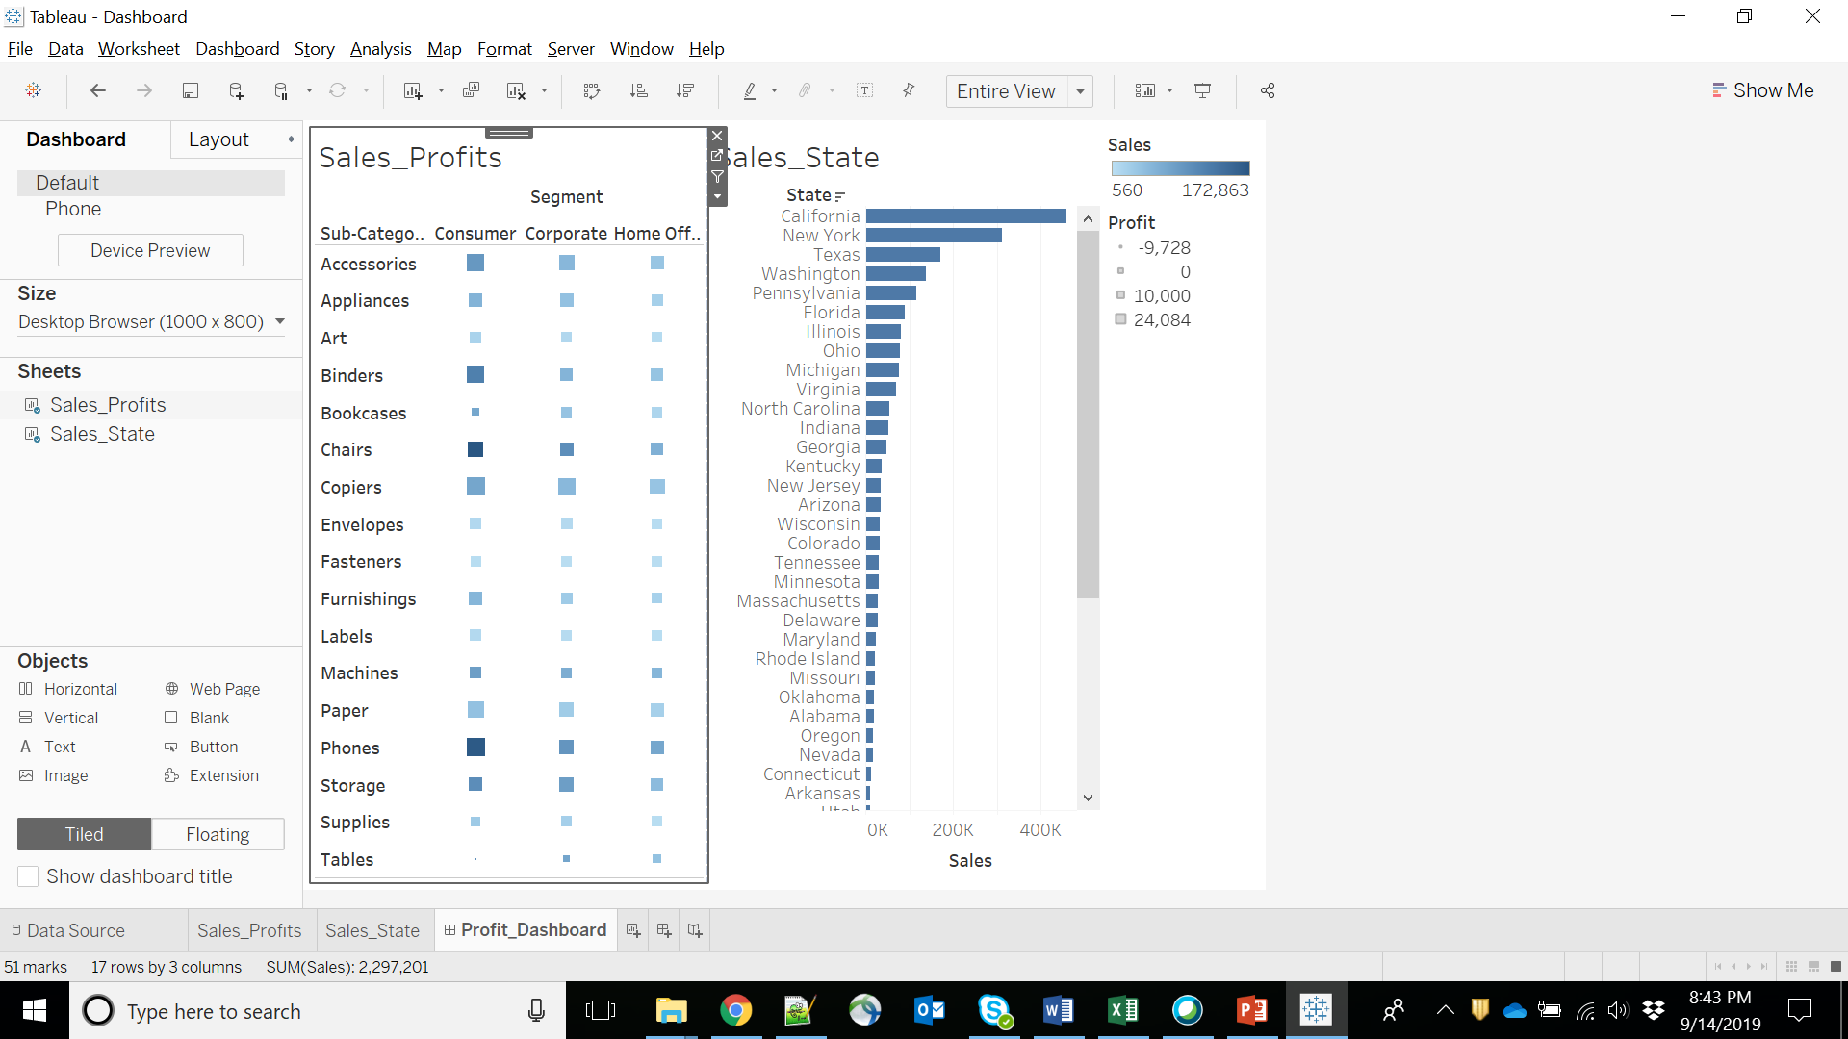

Slide 14
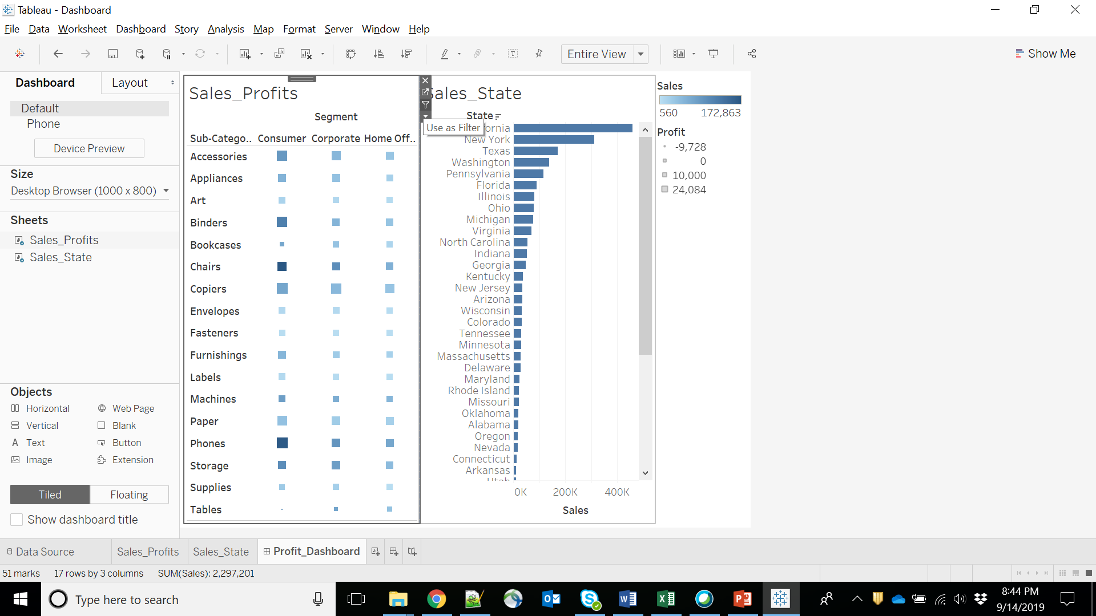

Slide 15
Step 5:
Now in the dashboard, click the box representing Sub-Category named Machines and segment named Consumer.
You can notice that only the states where the sales happened for this amount of profit are filtered out in the right pane named Sales_state.
This illustrates how the sheets are linked in a dashboard.

Slide 16
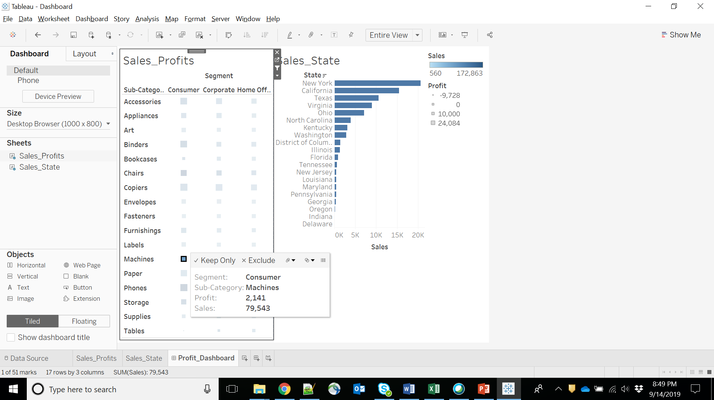

Slide 17
Pre Designing the layout with help of Objects Show Dashboard Title Horizontal and Vertical Floating and Tiled Text Image Web Page Blank Button Extension

Slide 18
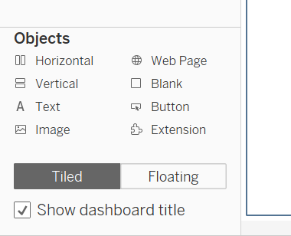
Dashboard Objects

Slide 19
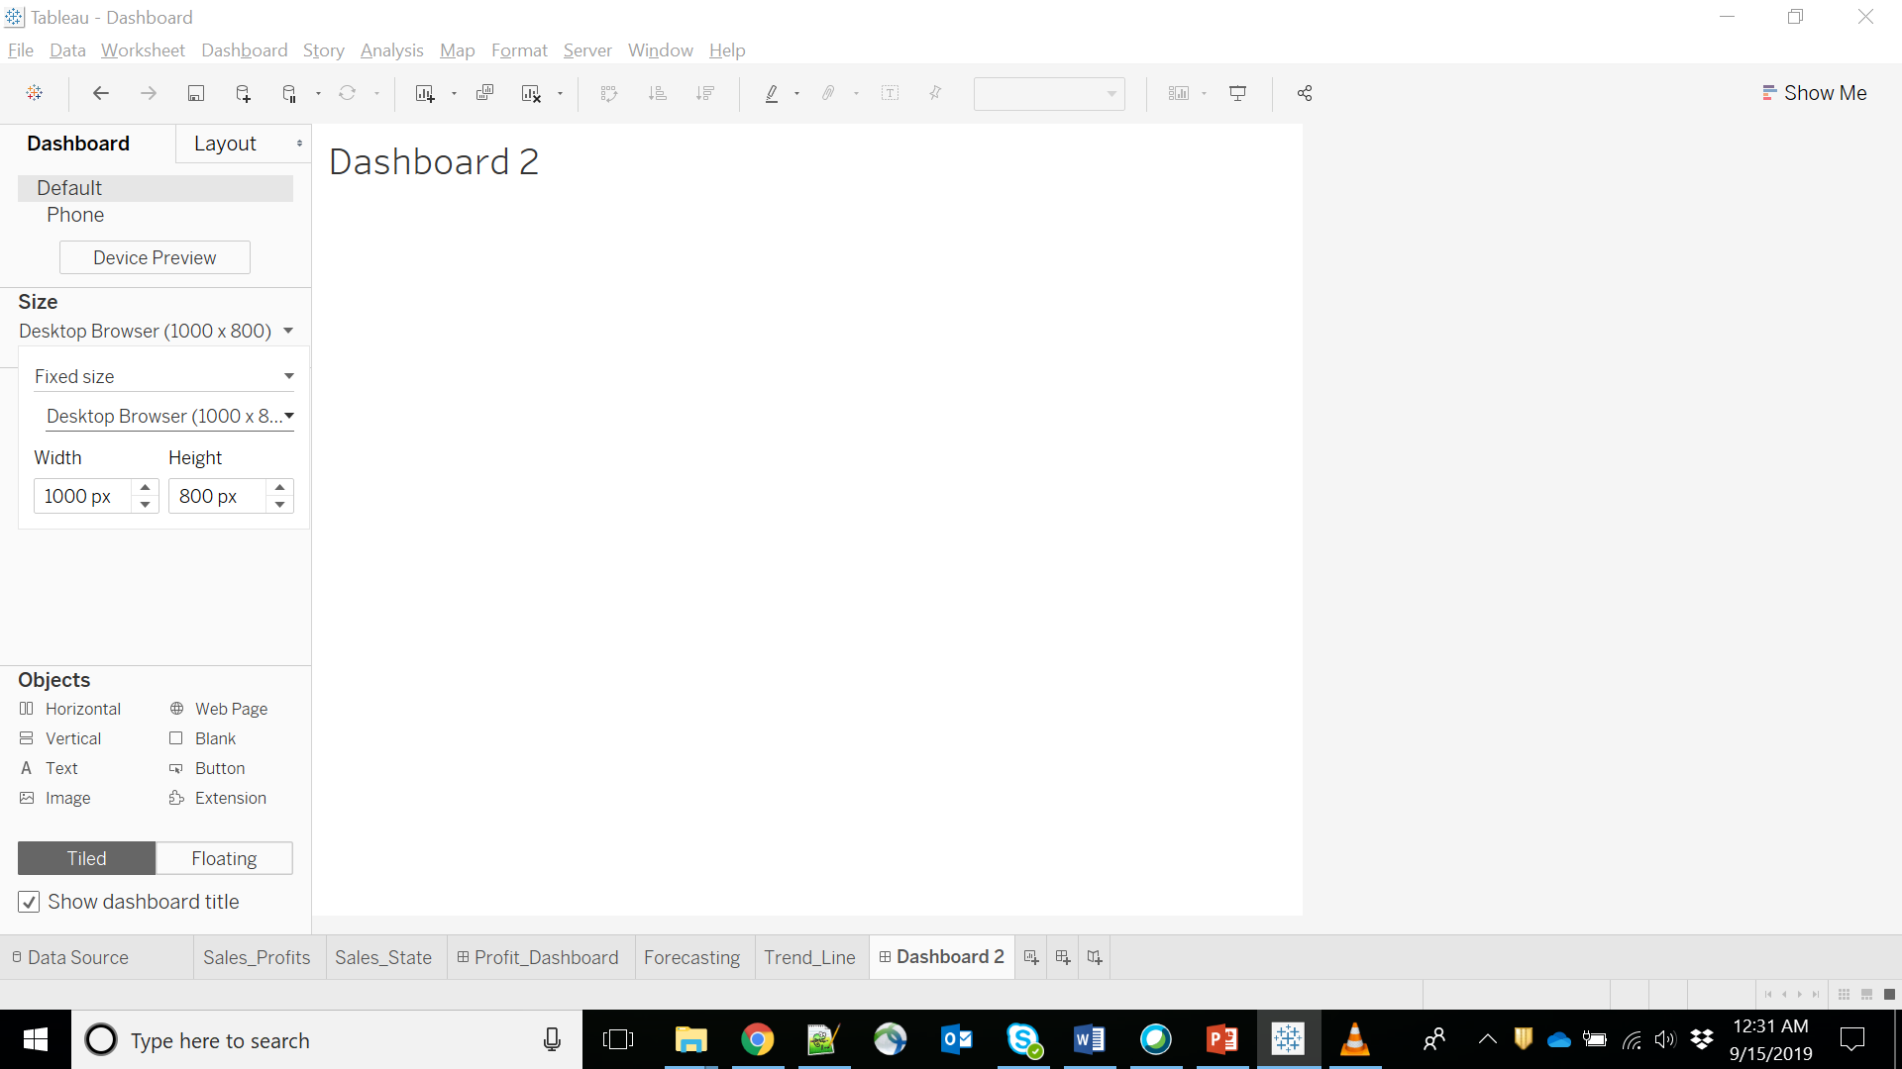
Dashboard Size
You can check Your Laptop’s Resolution, to set the perfect Resolution.

Slide 20
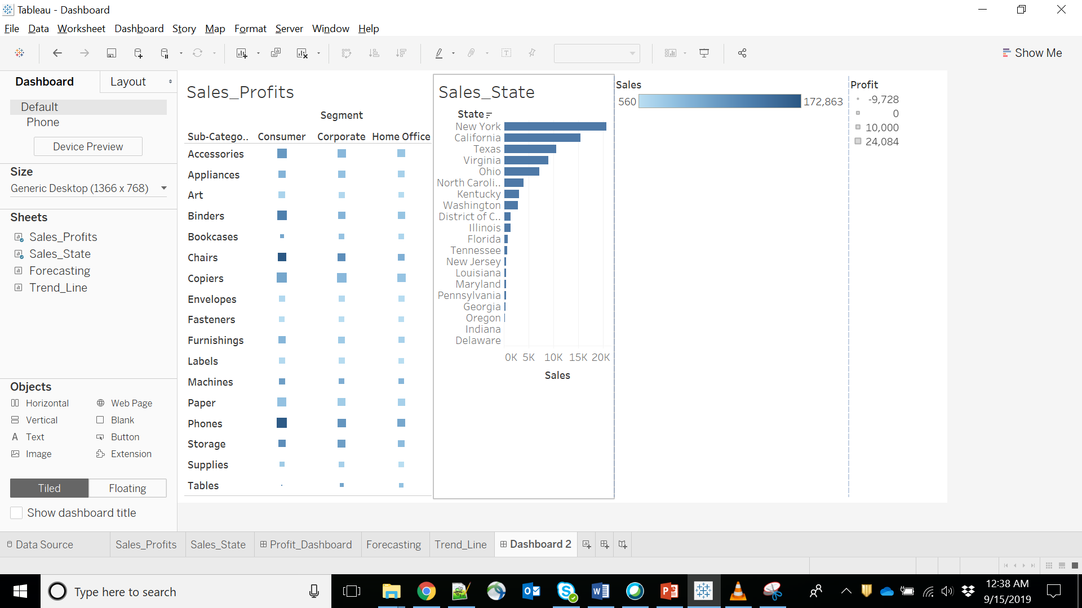
Horizontal Option

Slide 21
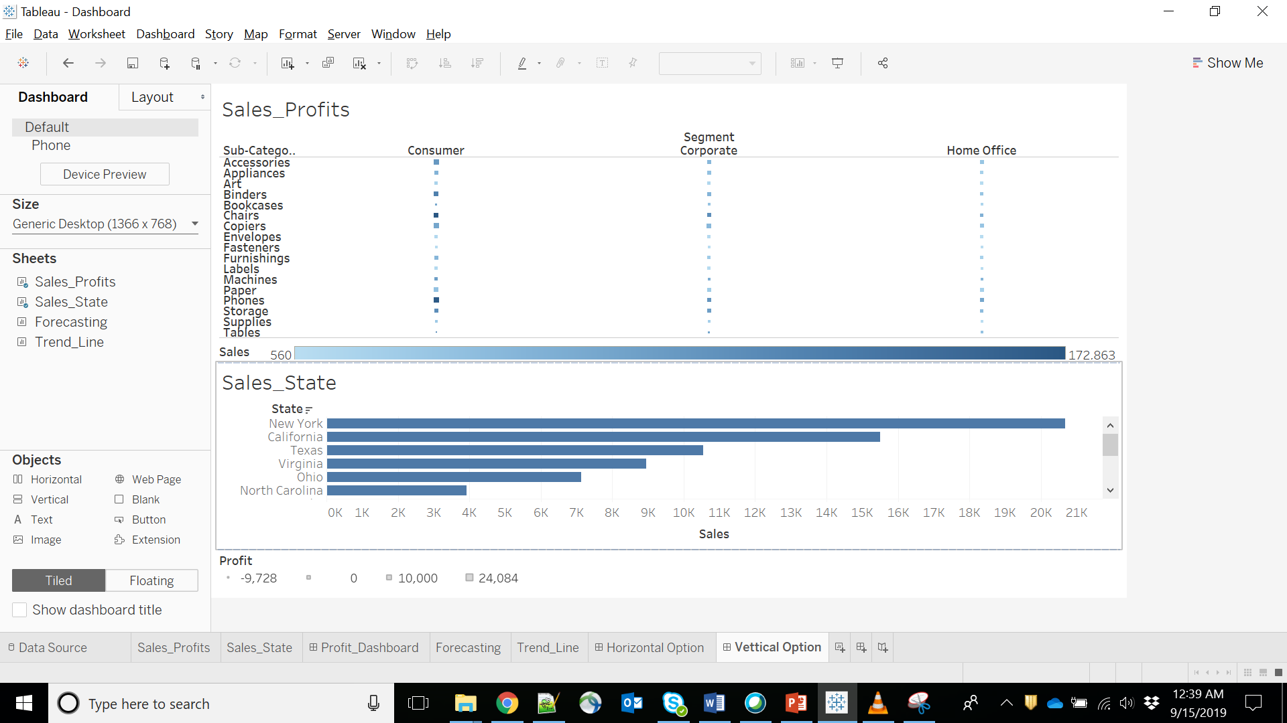
Vertical Option

Slide 22
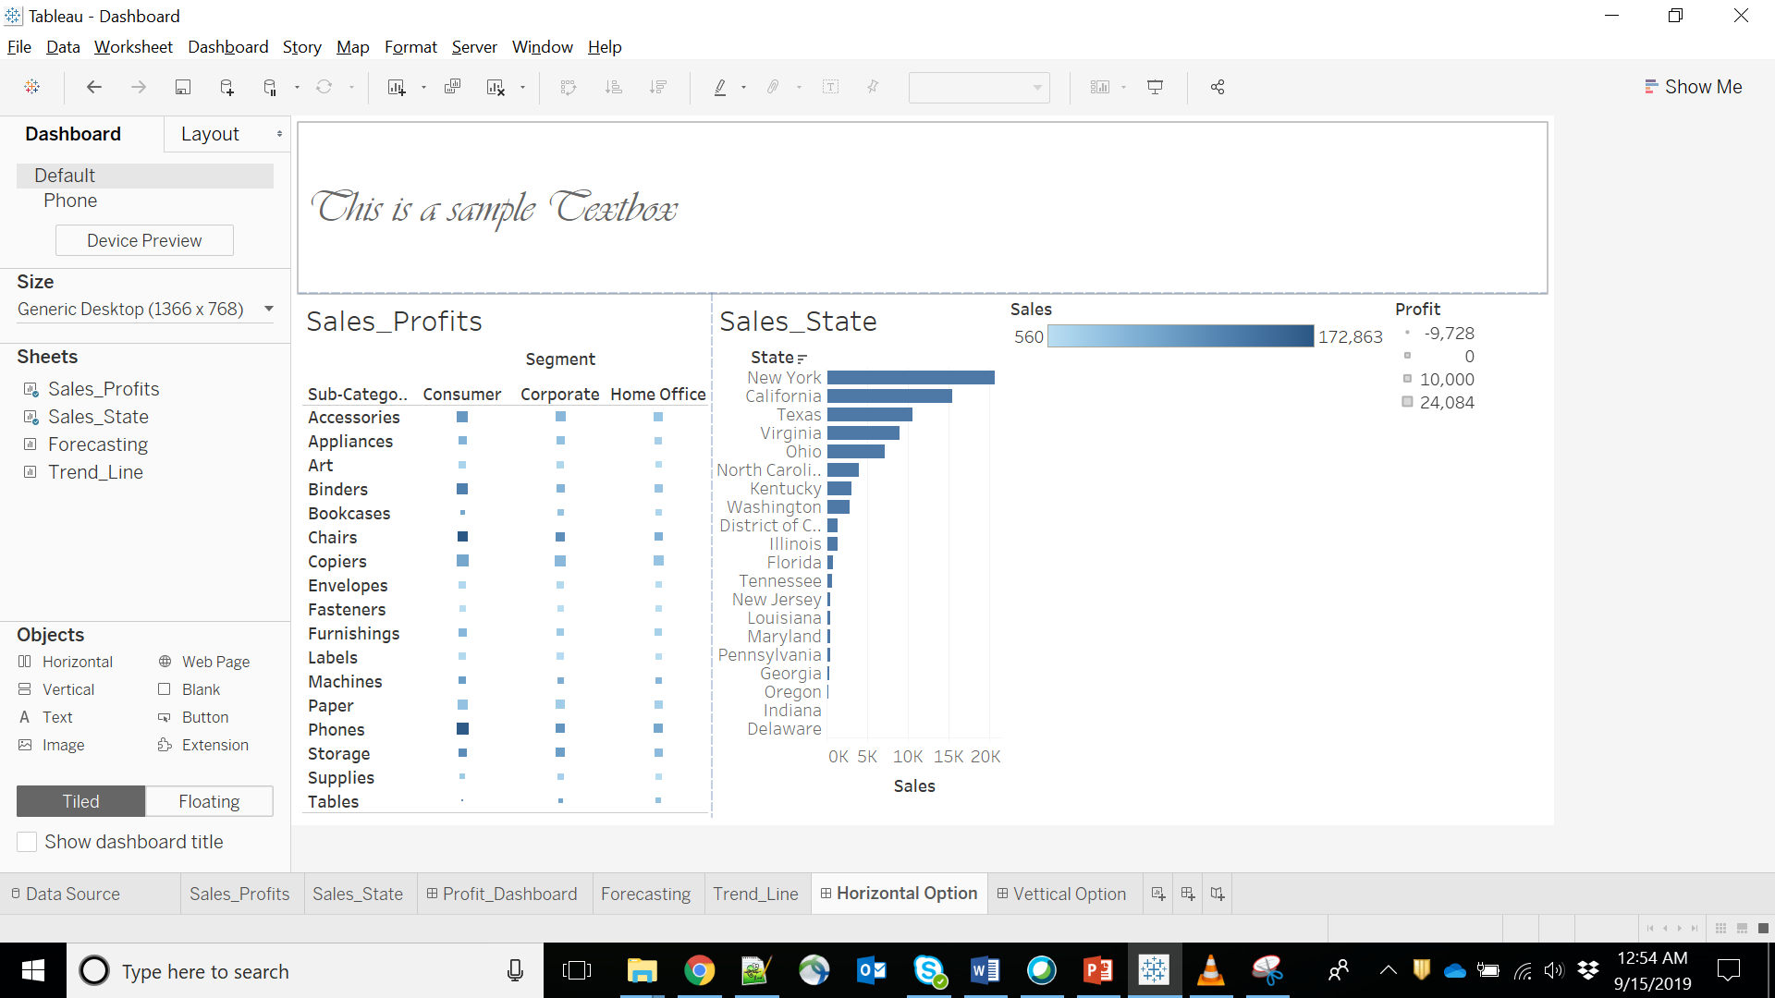
Adding Text..!

Slide 23
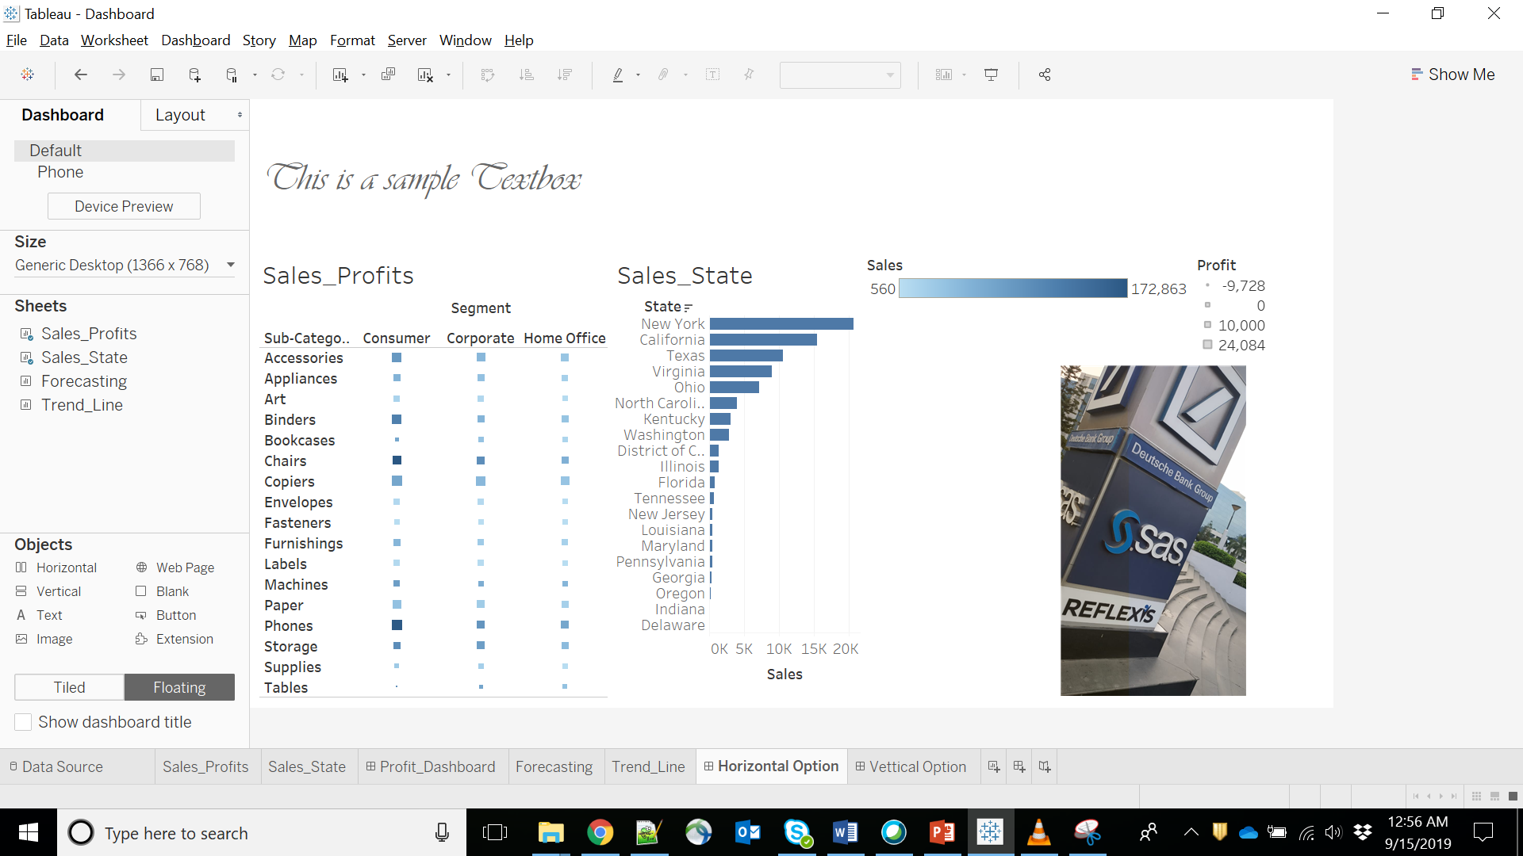
Adding Image..!

Slide 24
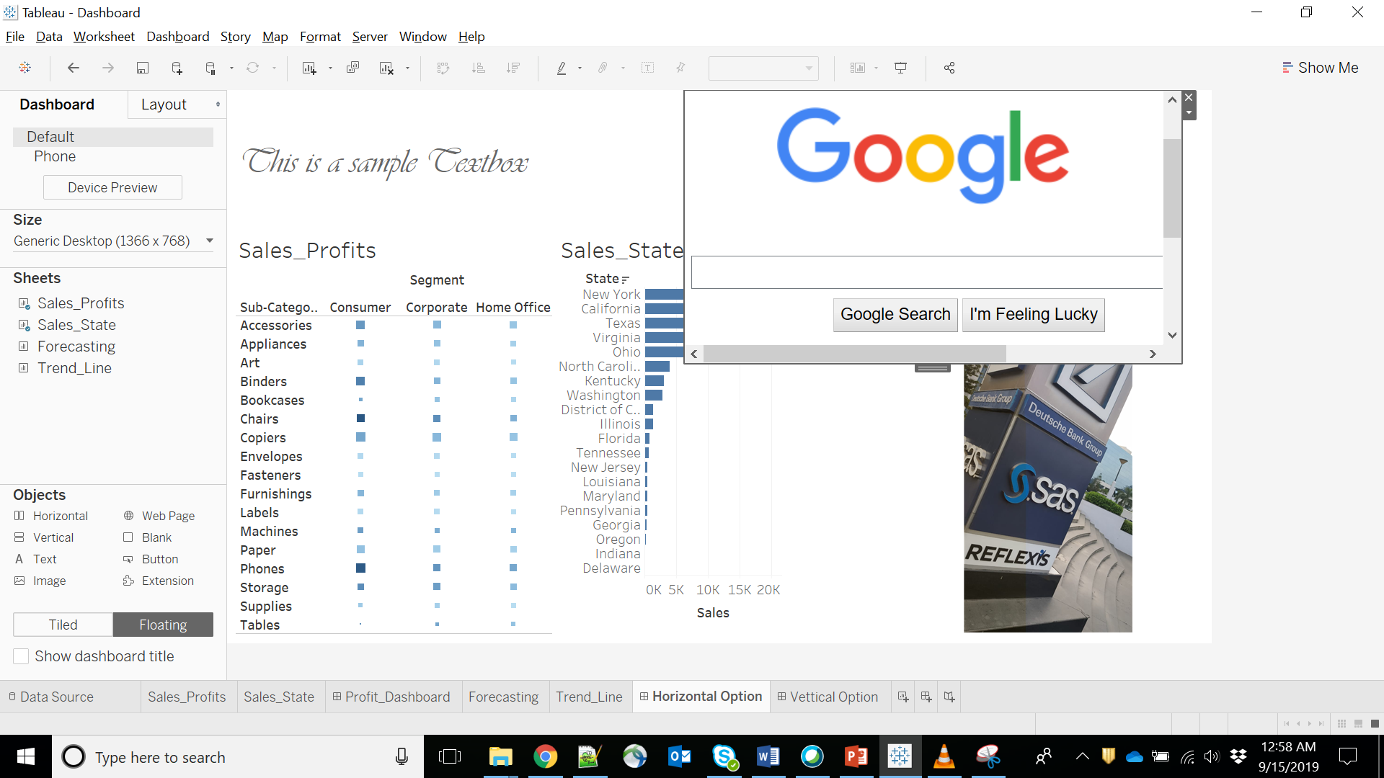
Adding Webpage..!

Slide 25
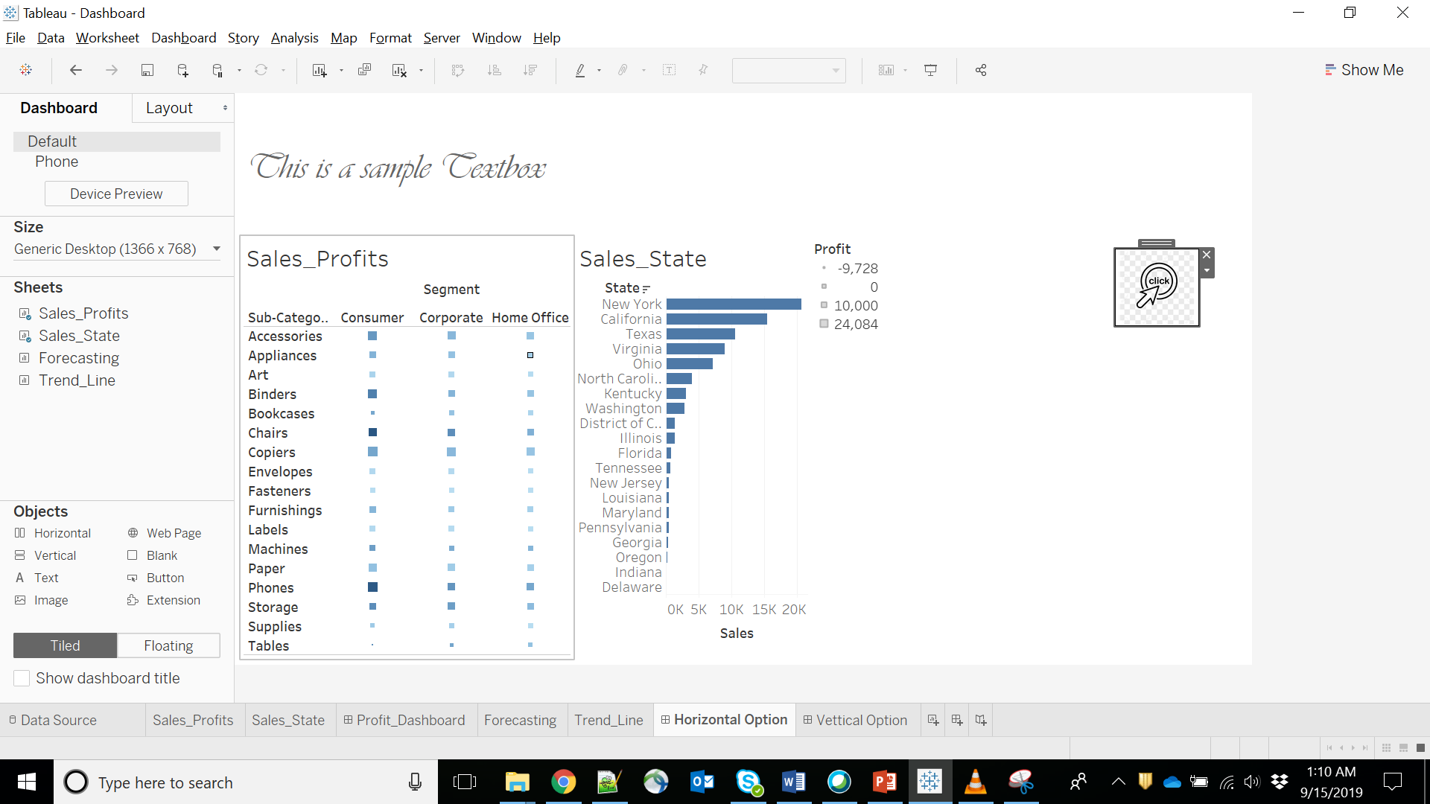
Adding Button..!

Slide 26
What is a Tableau Dashboard Extension
Tableau dashboard extensions are web applications that have two-way communication with the dashboard.
Dashboard extensions enable all sorts of scenarios, like letting you integrate Tableau with custom applications, making possible for you to modify the data for a viz, or even creating custom visualizations inside the dashboard.
A dashboard extension is just one type of extension that can be built using the Tableau Extensions API.
https://tableau.github.io/extensions-api/docs/trex_getstarted.html

Slide 27
Key Points..!
When creating a new dashboard, data pane is replaced with a list of worksheets .
Objects can be added by simply dragging them over to the dashboard.
By default, objects are added as “Tiled” and can be changed to “Floating” to allow overlap.
Tiled objects are best for adding worksheets to a dashboard .
Floating can be used with other dashboard objects.

Slide 28
Tableau - Forecasting
Forecasting is about predicting the future value of a measure.
There are many mathematical models for forecasting. Tableau uses the model known as exponential smoothing.
In exponential smoothing, recent observations are given relatively more weight than older observations. These models capture the evolving trend or seasonality of the data and extrapolate them into the future.
The result of a forecast can also become a field in the visualization created.

Slide 29
Step 1 − Create a line chart with Order Date (Year) in the columns shelf and Sales in the Rows shelf. Go to the Analysis tab as shown in the following screenshot and click Forecast under Model category.

Slide 30
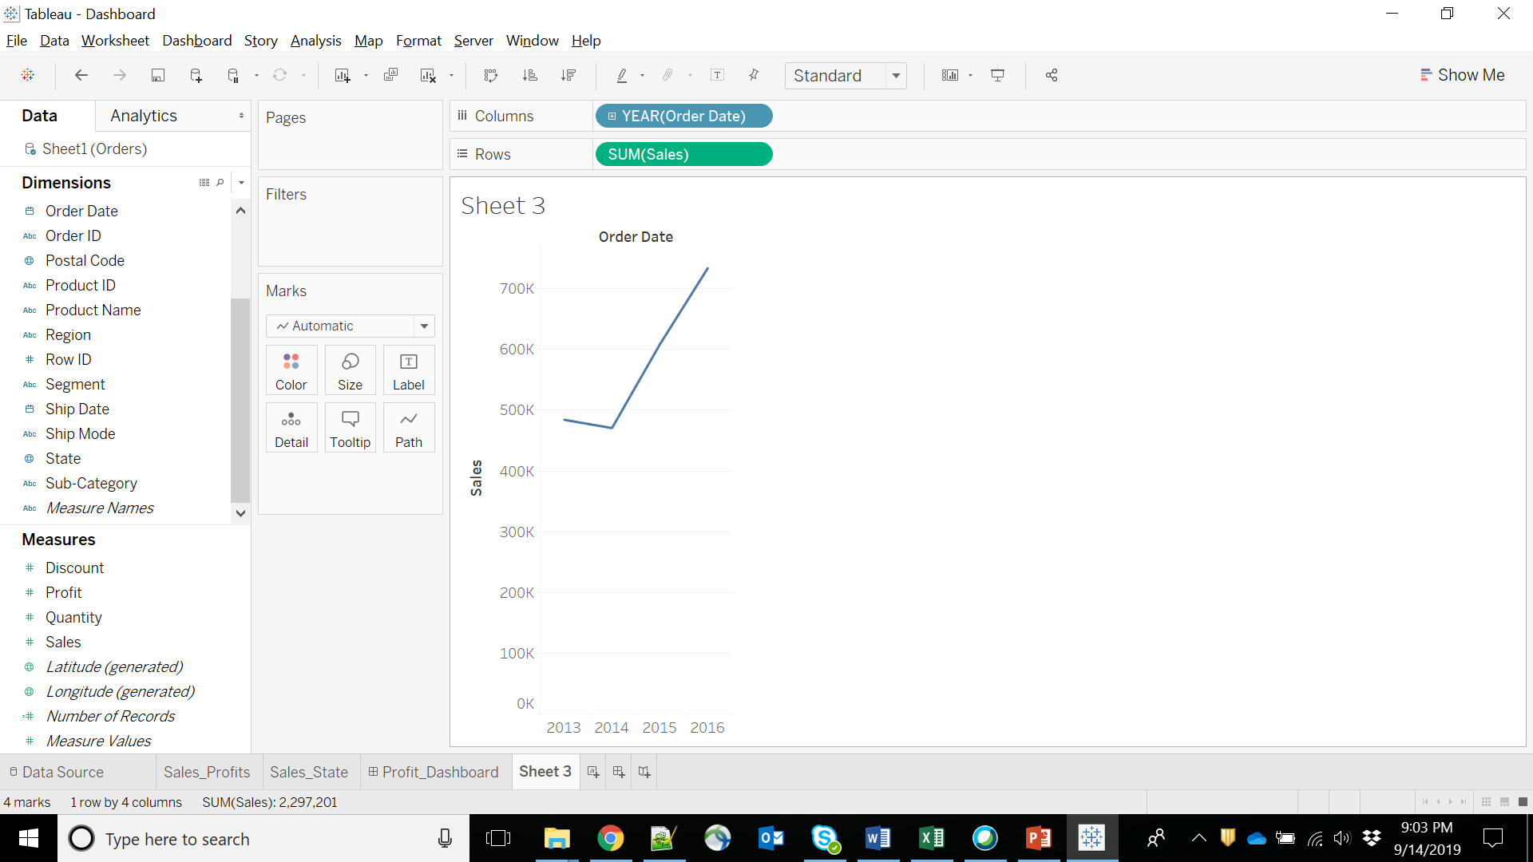
Creating a Forecast
Step 1 − Create a line chart with Order Date (Year) in the columns shelf and Sales in the Rows shelf.
Go to the Analysis tab as shown in the following screenshot and click Forecast under Model category.

Slide 31
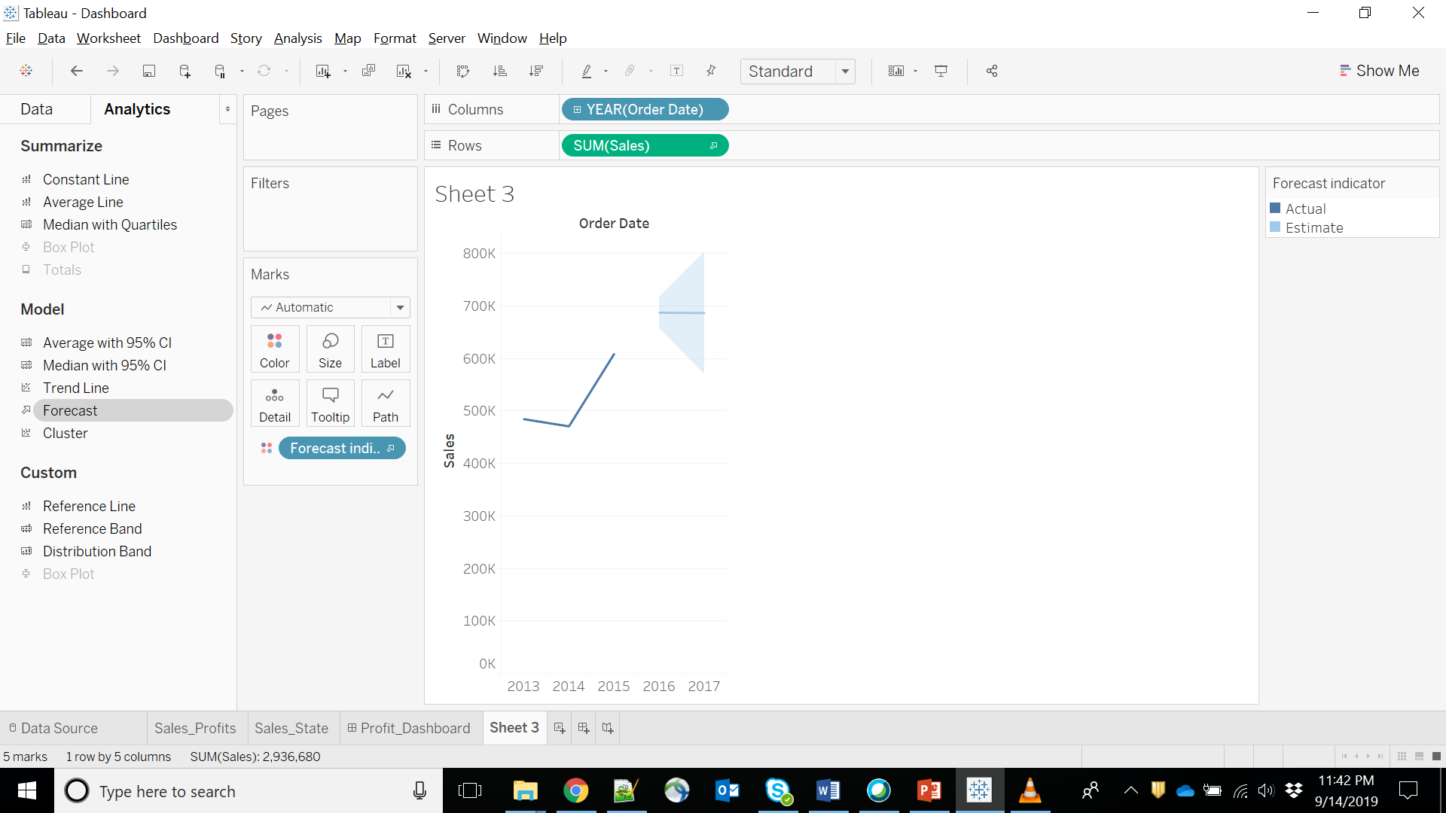

Slide 32
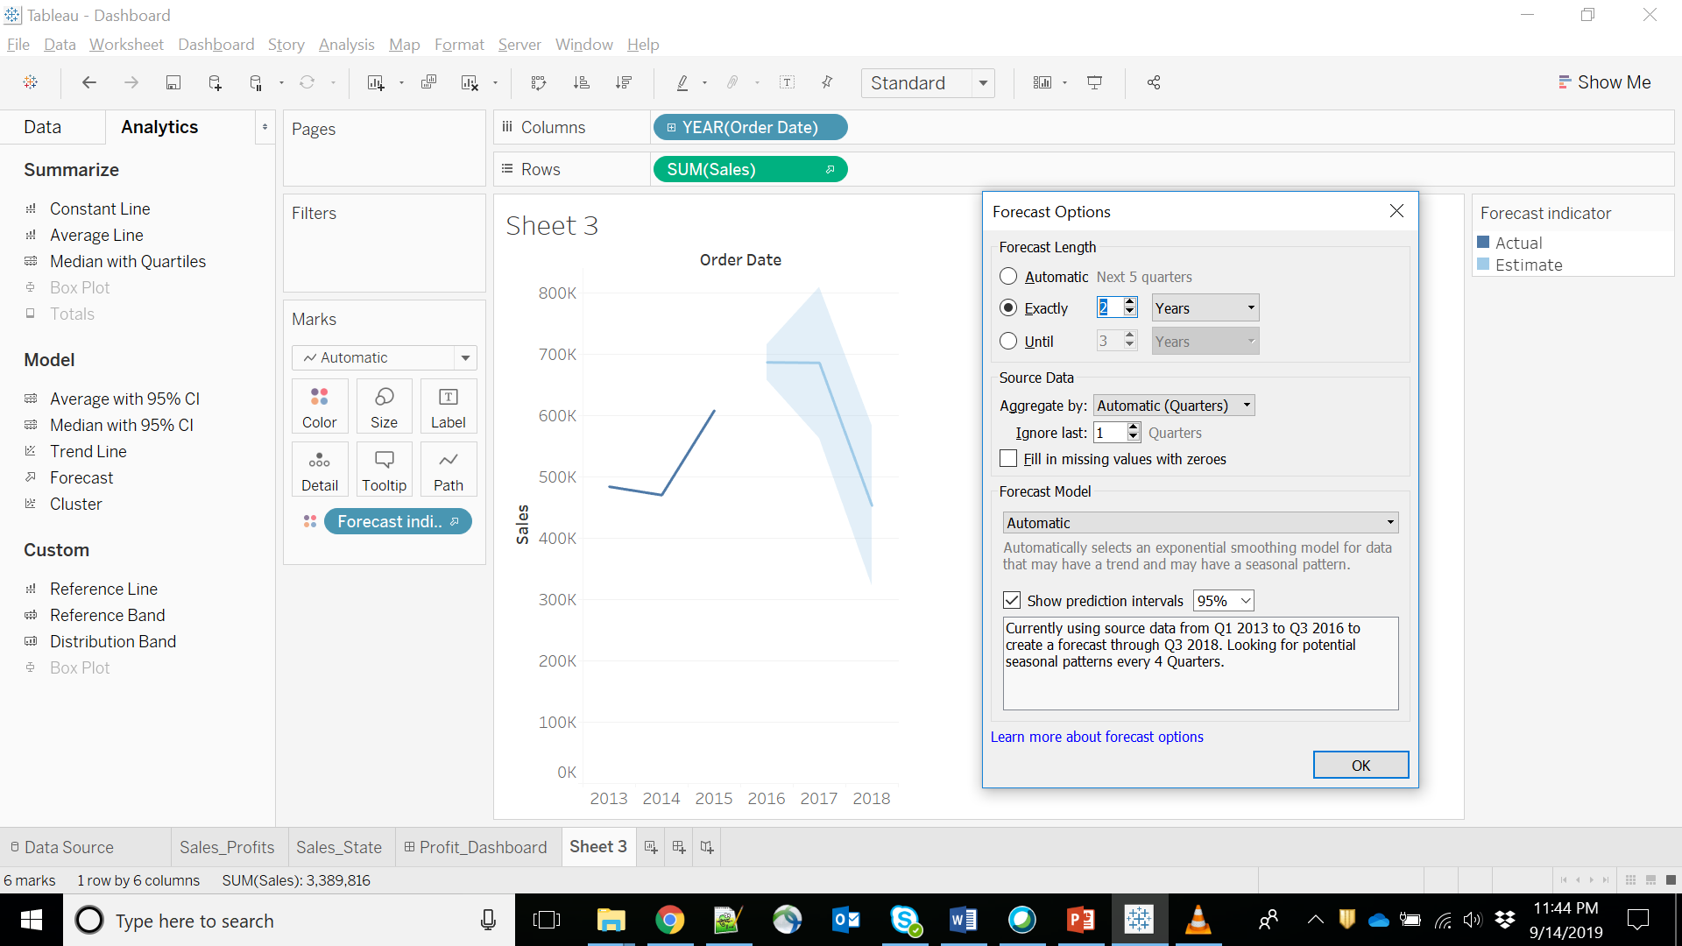
On completing the above step, you will find the option to set various options for forecast. Choose the Forecast Length as 2 years and leave the Forecast Model to Automatic as shown in the following screenshot.

Slide 33
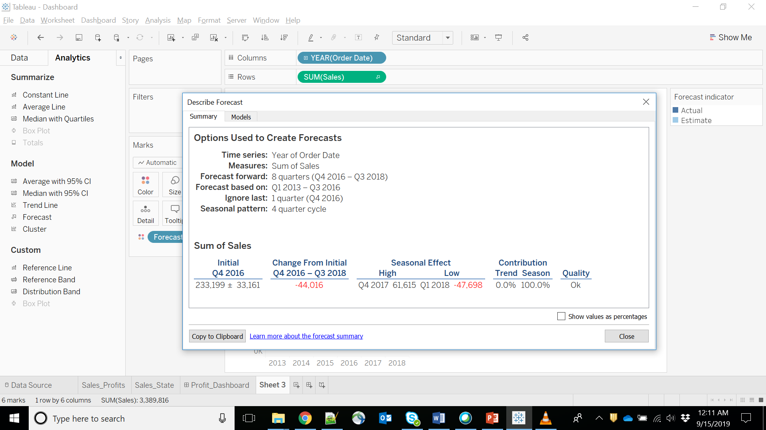
Describe the Forecast

Slide 34
Trend Lines
Trend lines are used to predict the continuation of a certain trend of a variable.
It also helps to identify the correlation between two variables by observing the trend in both of them simultaneously.
There are many mathematical models for establishing trend lines. Tableau provides four options.
They are Linear, Logarithmic, Exponential, and Polynomial.

Slide 35
Step 1:
Drag the dimension Order date to the Column shelf and the measure Sales to the Rows shelf. Choose the chart type as Line chart.
In the Analysis menu, go to model → Trend Line.
Clicking on Trend Line pops up an option showing different types of trend lines that can be added. Choose the linear model as shown in the following screenshot.

Slide 36
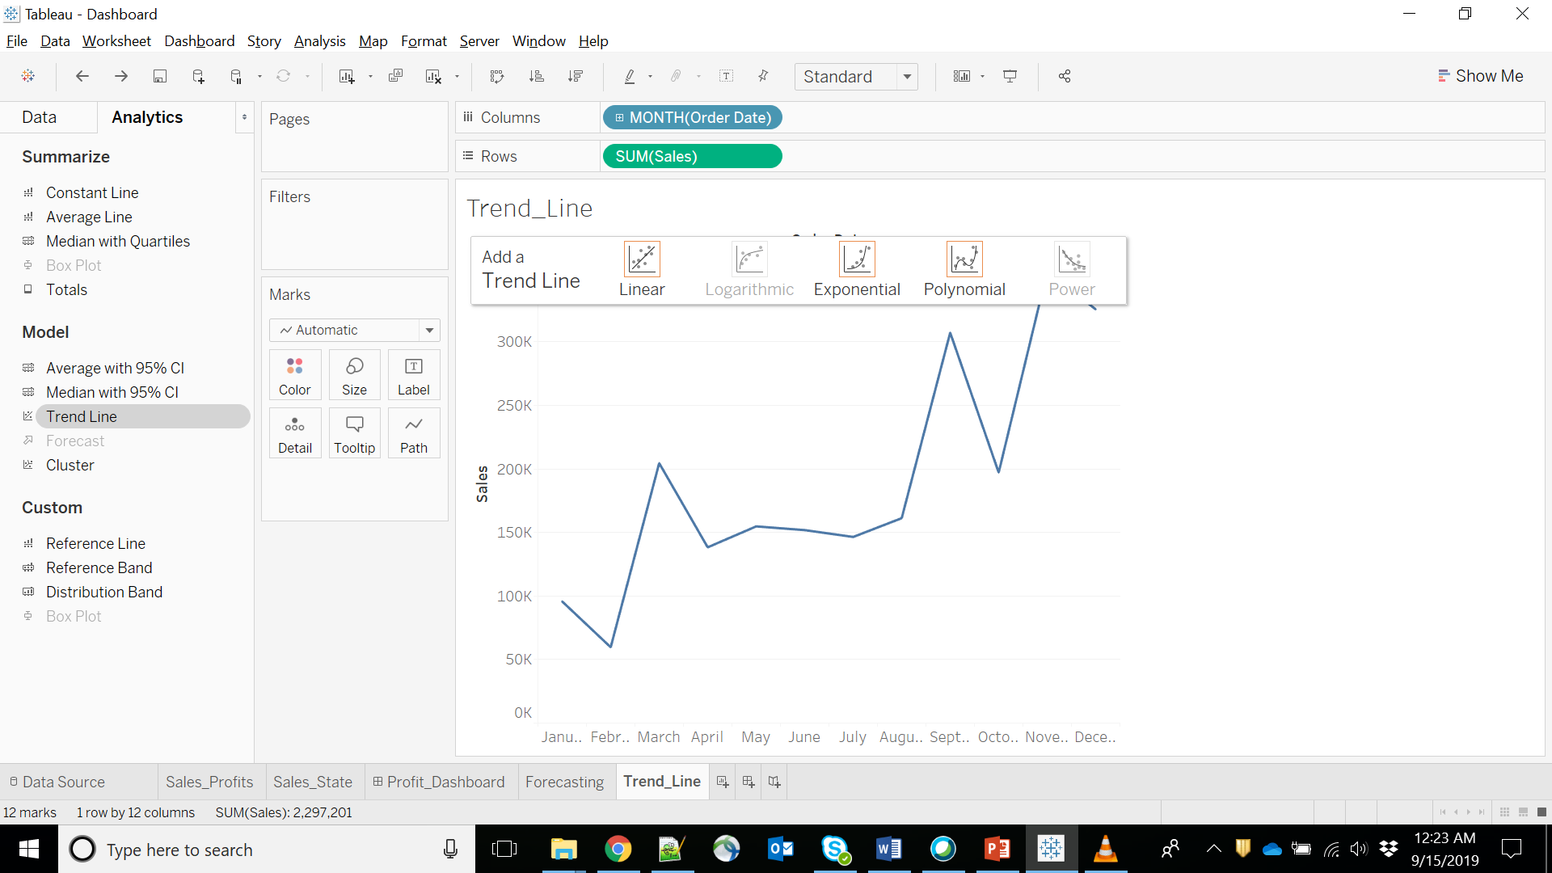

Slide 37
Step 2:
On completion of the above step, you will get various trend lines.
It also shows the mathematical expression for the correlation between the fields, the P-Value and the R-Squared value.

Slide 38


Slide 39
Step 3:
Right-click on the chart and select the option Describe Trend Line to get a detailed description of the Trend Line chart.
It shows the coefficients, intercept value, and the equation.
These details can also be copied to the clipboard and used in further analysis.

Slide 40
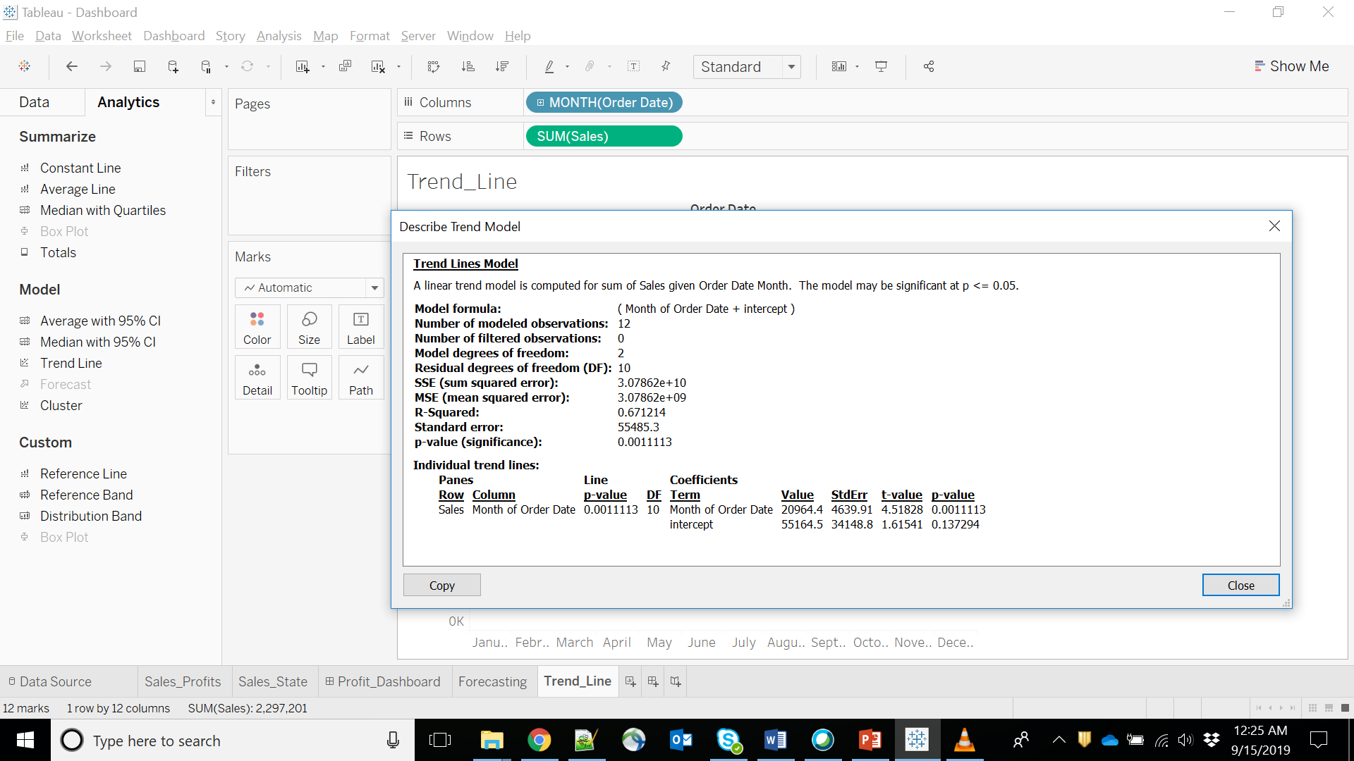

Slide 41
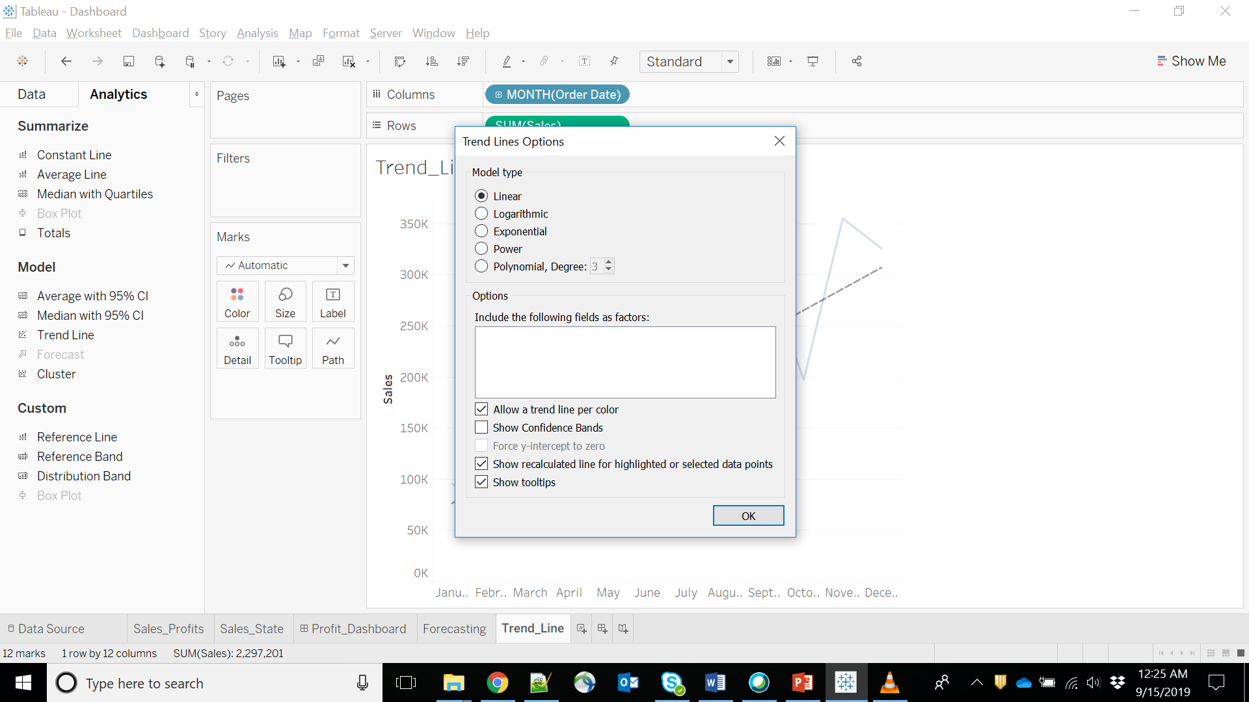

Slide 42
Clusters
Let’s head back to the Sales and Profit Analysis chart that we had made.
Let’s make that a bit more prominent now, using Clusters.

Slide 43
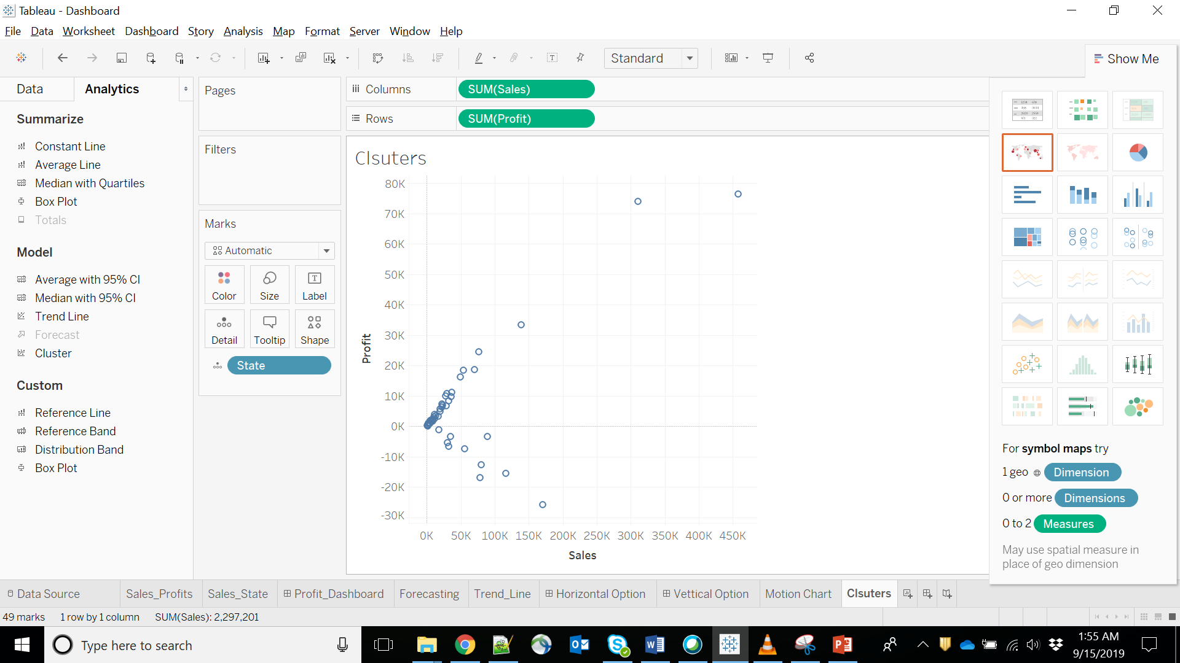

Slide 44
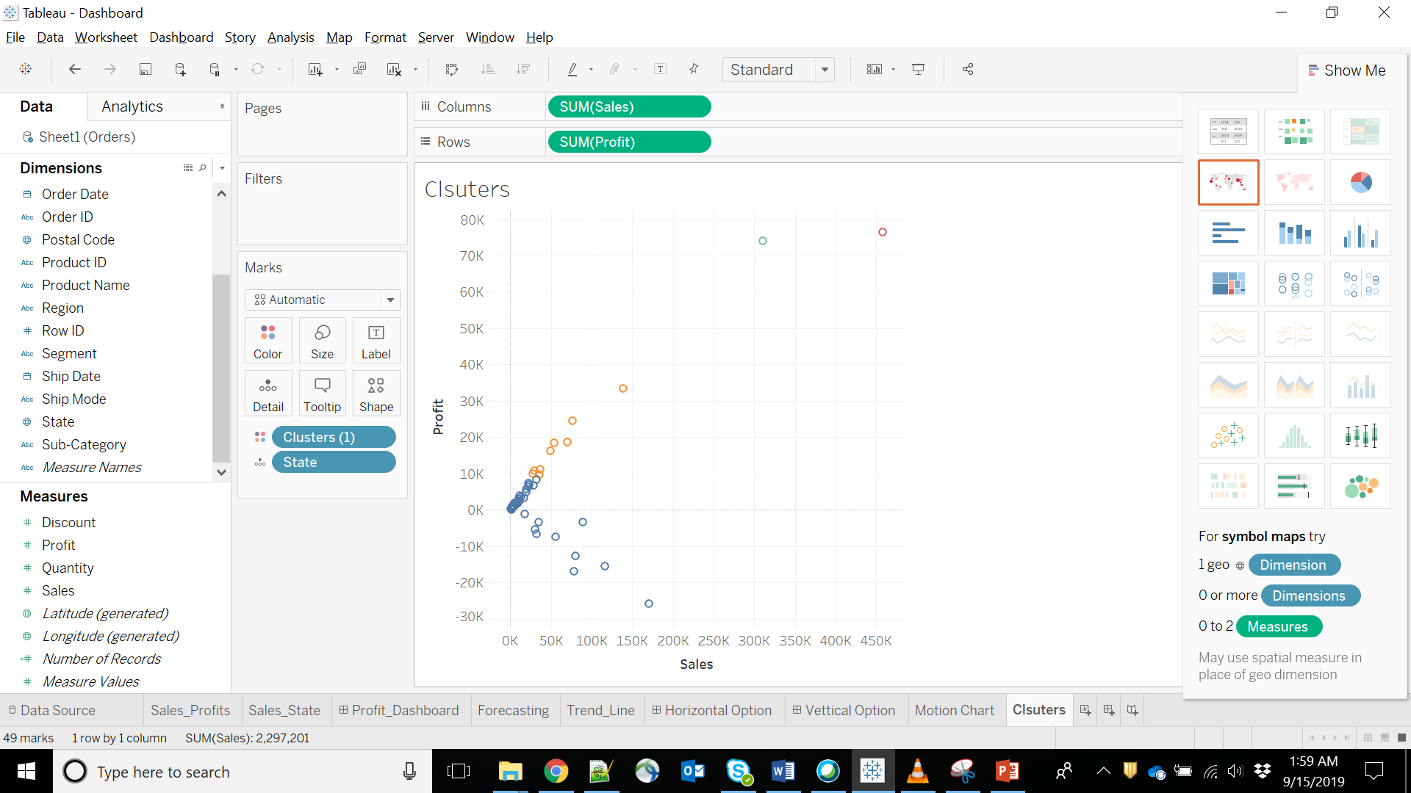

Slide 46
